Slide 1
Non-Parametric Test
B.SC CSIT 3rd Semester
Central Campus of Techonlogy

Slide 2
Non-Parametric Test:
A non parametric test, also known as distribution free test, is a statistical hypothesis test that does not make any assumptions about the underlying distribution of the population from which the data is drawn. Unlike parametric tests, which require specific assumption about the distribution( such as normality), non – parametric tests provide a more flexible approach to analyze data when these assumptions can not be met or are unknown. Some common non-parametric tests include: Mann-Whitney U test, Kruskal-Wallis H test, Wilcoxon signed rank test, chi-square test, Friedman test etc.

Slide 3
Difference between Parametric and Non-Parametric Test:
Parametric Test
Non- Parametric test
It specifies certain condition about parameter of the population from which sample is selected
It is used data which are measured in interval and ratio scale.
It is used in testing of hypothesis and estimated of parameters.
It is most powerful test.
It required complicated sampling technique.
It does not specify certain condition about parameter of the population from which sample is selected.
It is used data which are measured in nominal and ordinal scale.
It is used in testing of hypothesis but not in estimation of parameters.
It is less powerful.
It does not require complicated sampling technique.

Slide 4
Advantage and Disadvantage:
Advantage
Disadvantage
It is simple to understand , quicker, an easier to apply.
It is less time consuming.
It needs no assumption about the population from which sample is selected.
It has greater range of applicability because of milder assumption.
It does not require complicated sampling theory .
It can not be used to estimate the parameters of population.
These tests are less reliable and less powerful than parametric tests.
These tests are less efficient than parametric tests.
In these tests many times lot of information are discarded or unused.

Slide 5
Application of Non-Parametric Test:
When data size is small, parameter free it applied.
When assumptions of parametric procedure are not satisfied.
When quick or preliminary data analysis is required.
When data are weak scaled.
When data show highly skewed nature ( large positive/ negative skeweness).
When basic question of interest is distribution free in nature.

Slide 6
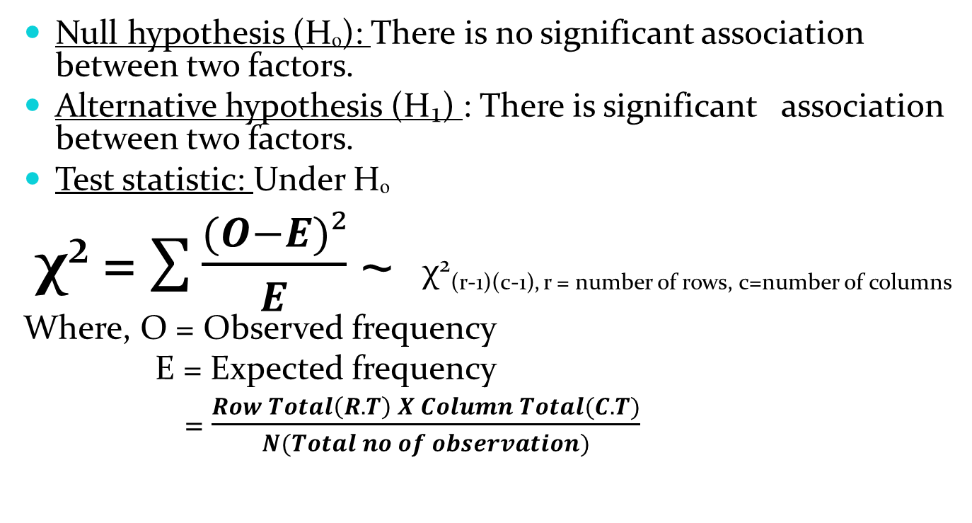
Chi-Square(χ²) Test:
Null hypothesis (Hₒ): There is no significant association between two factors.
Alternative hypothesis (H₁) : There is significant association between two factors.
Test statistic: Under Hₒ
χ² = $\sum{\frac{(O−E)²}{E}}$ ~ χ²(r-1)(c-1), r = number of rows, c=number of columns
Where, O = Observed frequency
E = Expected frequency
= $\frac{Row Total\left(R.T\right) X Column Total(C.T)}{N(Total no of observation)}$

Slide 7

Contingency table:
For 2x2 contingency table the value of χ² is directly calculated by using formula
χ² = $\frac{N(ad−bc)²}{\left(a+b\right)(c+d)(a+c)(b+d)}$ ~ χ²₍₁₎
 | A₁ | A₂ | Total
B₁ | a | b | a + b
B₂ | c | d | c + d
Total | a + c | b + d | N = a +b +c + d

Slide 8
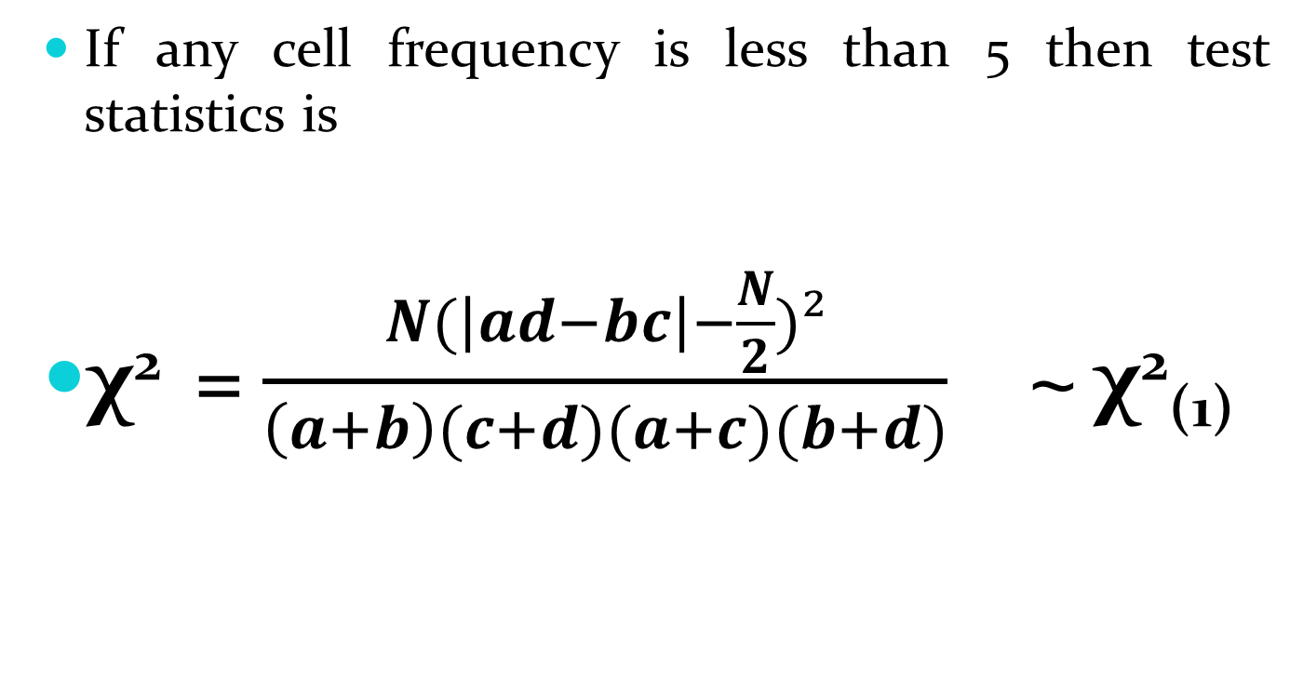
Yates correction for continuity:
If any cell frequency is less than 5 then test statistics is
χ² = $\frac{N(\left|ad−bc\right|−\frac{N}{2})²}{\left(a+b\right)(c+d)(a+c)(b+d)}$ ~ χ²₍₁₎

Slide 9
Problems:
A tobacco company claims that there is no relationship between smoking and lung aliments. To investigate the claims random sample of 300 males in age group of 40 to 50 is given medical test. The observed sample result are tabulated below.
On the basis of this information, can it be concluded that smoking and lung ailment are independent.
 | Lung ailment | No lung ailment
Smokers | 75 | 105
No smokers | 25 | 95

Slide 10
Problems:
Test whether the color of son’s eyes is associated with that of the father’s at 5% level of significance using the data available in the following table.
Father’s eye color | Son’s eye color
 | Not light | Light
Not light | 230 | 148
Light | 151 | 471

Slide 11
Problems:
88 workers of a IT company were interview during a sample survey for their smoking habit. Classification of respondents according to their gender and their smoking habit are found as
Do the smoking habit is associated with gender
Habit | Sex
 | Male | Female
Smoker | 40 | 33
Non-smoker | 3 | 12

Slide 12
Problems:
The distribution of persons according to sex and blood groups are given below:
Is there any association between sex and blood group?
 | Blood group
Sex | O | A | B | AB
Male | 100 | 40 | 45 | 10
Female | 110 | 35 | 55 | 5

Slide 13
Problems:
A sample of employees at a large chemical plant was asked to indicate a preference for one of those three pension plans. The results are given in the following table. Does it seems that there is a relationship between the pension plan selected and the job classification of the employees?
Job class | Pension Plan
 | A | B | C
Supervisor | 32 | 17 | 17
Clerical | 12 | 22 | 22
Labor | 12 | 22 | 12

Slide 14
Problems:
In an experiment to study the dependence of hypertension on smoking habits, the following data were taken on 180 individuals:
Test the hypothesis that presence or absence of hypertension is independent of smoking habit.
 | No smokers | Moderate smokers | Heavy smokers
Hypertension | 21 | 36 | 36
No hypertension | 48 | 26 | 19

Slide 15
